Slide 1


Retail Banking System
INTCDE21IJ011 MFPE POD 3

Slide 2

Project Overview
One of the largest and leading Retail Bank within the US, serving millions of customers across the country offering a range of financial products from Credit Cards, Savings & Checking accounts, Auto loans, small business & commercial accounts. The retail bank has historically been served by a large monolith system. This system has Customer information, Transaction information, Account information – Pretty much a ledger generating taxes & statements. The bank is looking for a solution that will provide resilience & scalability for future growth.
Following are the required features:
Highly available
Highly scalable
Highly Performant
Easily built and maintained
Developed and deployed quickly

Slide 3





Microservices
Authentication Microservice
Customer Microservice
Account Microservice
Transaction Microservice
Rules Microservice
Responsible for Security and generating JWT Token for Roles based Logins
Responsible for creating, updating and viewing Customers
Responsible for creating bank account, viewing account details and statements
Responsible for transact operations like withdraw, deposits, transfer and viewing transaction details
Responsible for evaluating minimum balance rule while performing transactions and evaluates monthly charge

Slide 4
Microservices
UI Portal
Customer Microservice
Account Microservice
Authentication Microservice
Transaction Microservice
Rules Microservice

Slide 5
Authentication Microservice
Authentication Microservice is used by all the microservices to perform the operations that only if the logged in user has the privileges to.
Post: /login
Get: /validateToken
Get: /role/{userid}
Authentication Microservice
Handle Login
Handle Logout
Validate Token
Get the Role

Slide 6
Customer Microservice
Customer Microservice is used to handle the data of a customer and perform various operations with that data.
Post: /createcustomer
Get: /getcustomerdetails
Customer Microservice
Create Customer
Get Details
Delete Customer
Update Customer

Slide 7
Account Microservice
Account Microservice is used to handle the data of a customer’s account. And perform various operations with that data.
Post: /createAccount
Get: /getCustomerAccounts
Get: /getAccount
Get: /getAccountStatement
Post: /deposit
Post: /withdraw
Account Microservice
Account Creation
Get Details
Display Accounts
Deposit Money
Withdraw
Statement

Slide 8
Transaction Microservice
Transaction Microservice is used to handle the transaction data for account. And perform various operations with that data.
Post: /deposit
Post: /withdraw
Post: /transafer
Get: /getTransactionDetails
Transaction Microservice
Get Transaction
Withdraw
Transfer
Deposit

Slide 9
Rules Microservice
Rules Microservice is used to provide certain rules to check the minimum criteria for transaction. It performs the following operations.
GET: /evaluateMinBal
GET: /getServiceCharges
Rules Microservice
Evaluate Minimum Balance
Deduct Service Charge

Slide 10
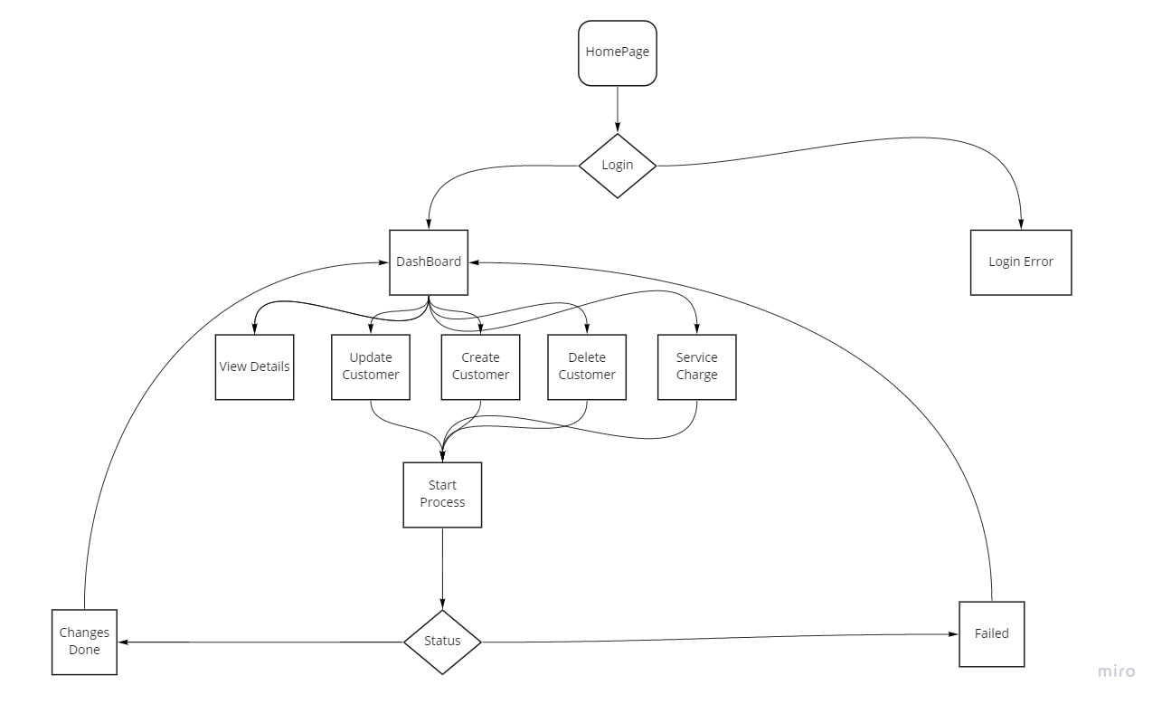
DFD Admin

Slide 11
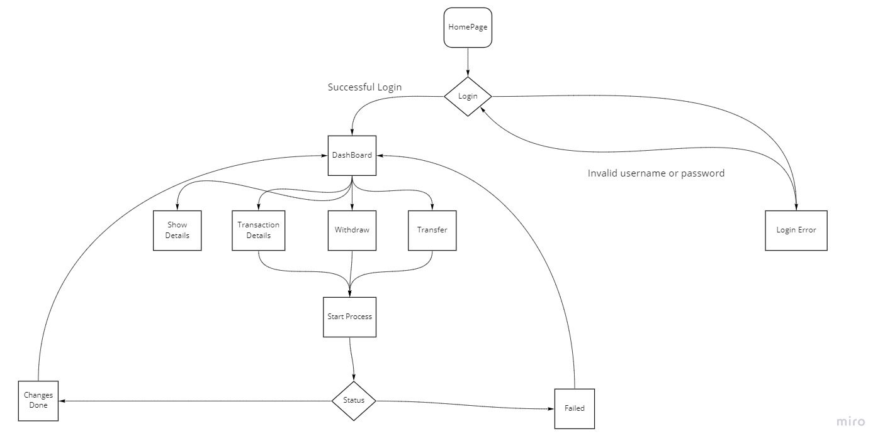
DFD Customer

Slide 12
Frontend Snapshots

Slide 13
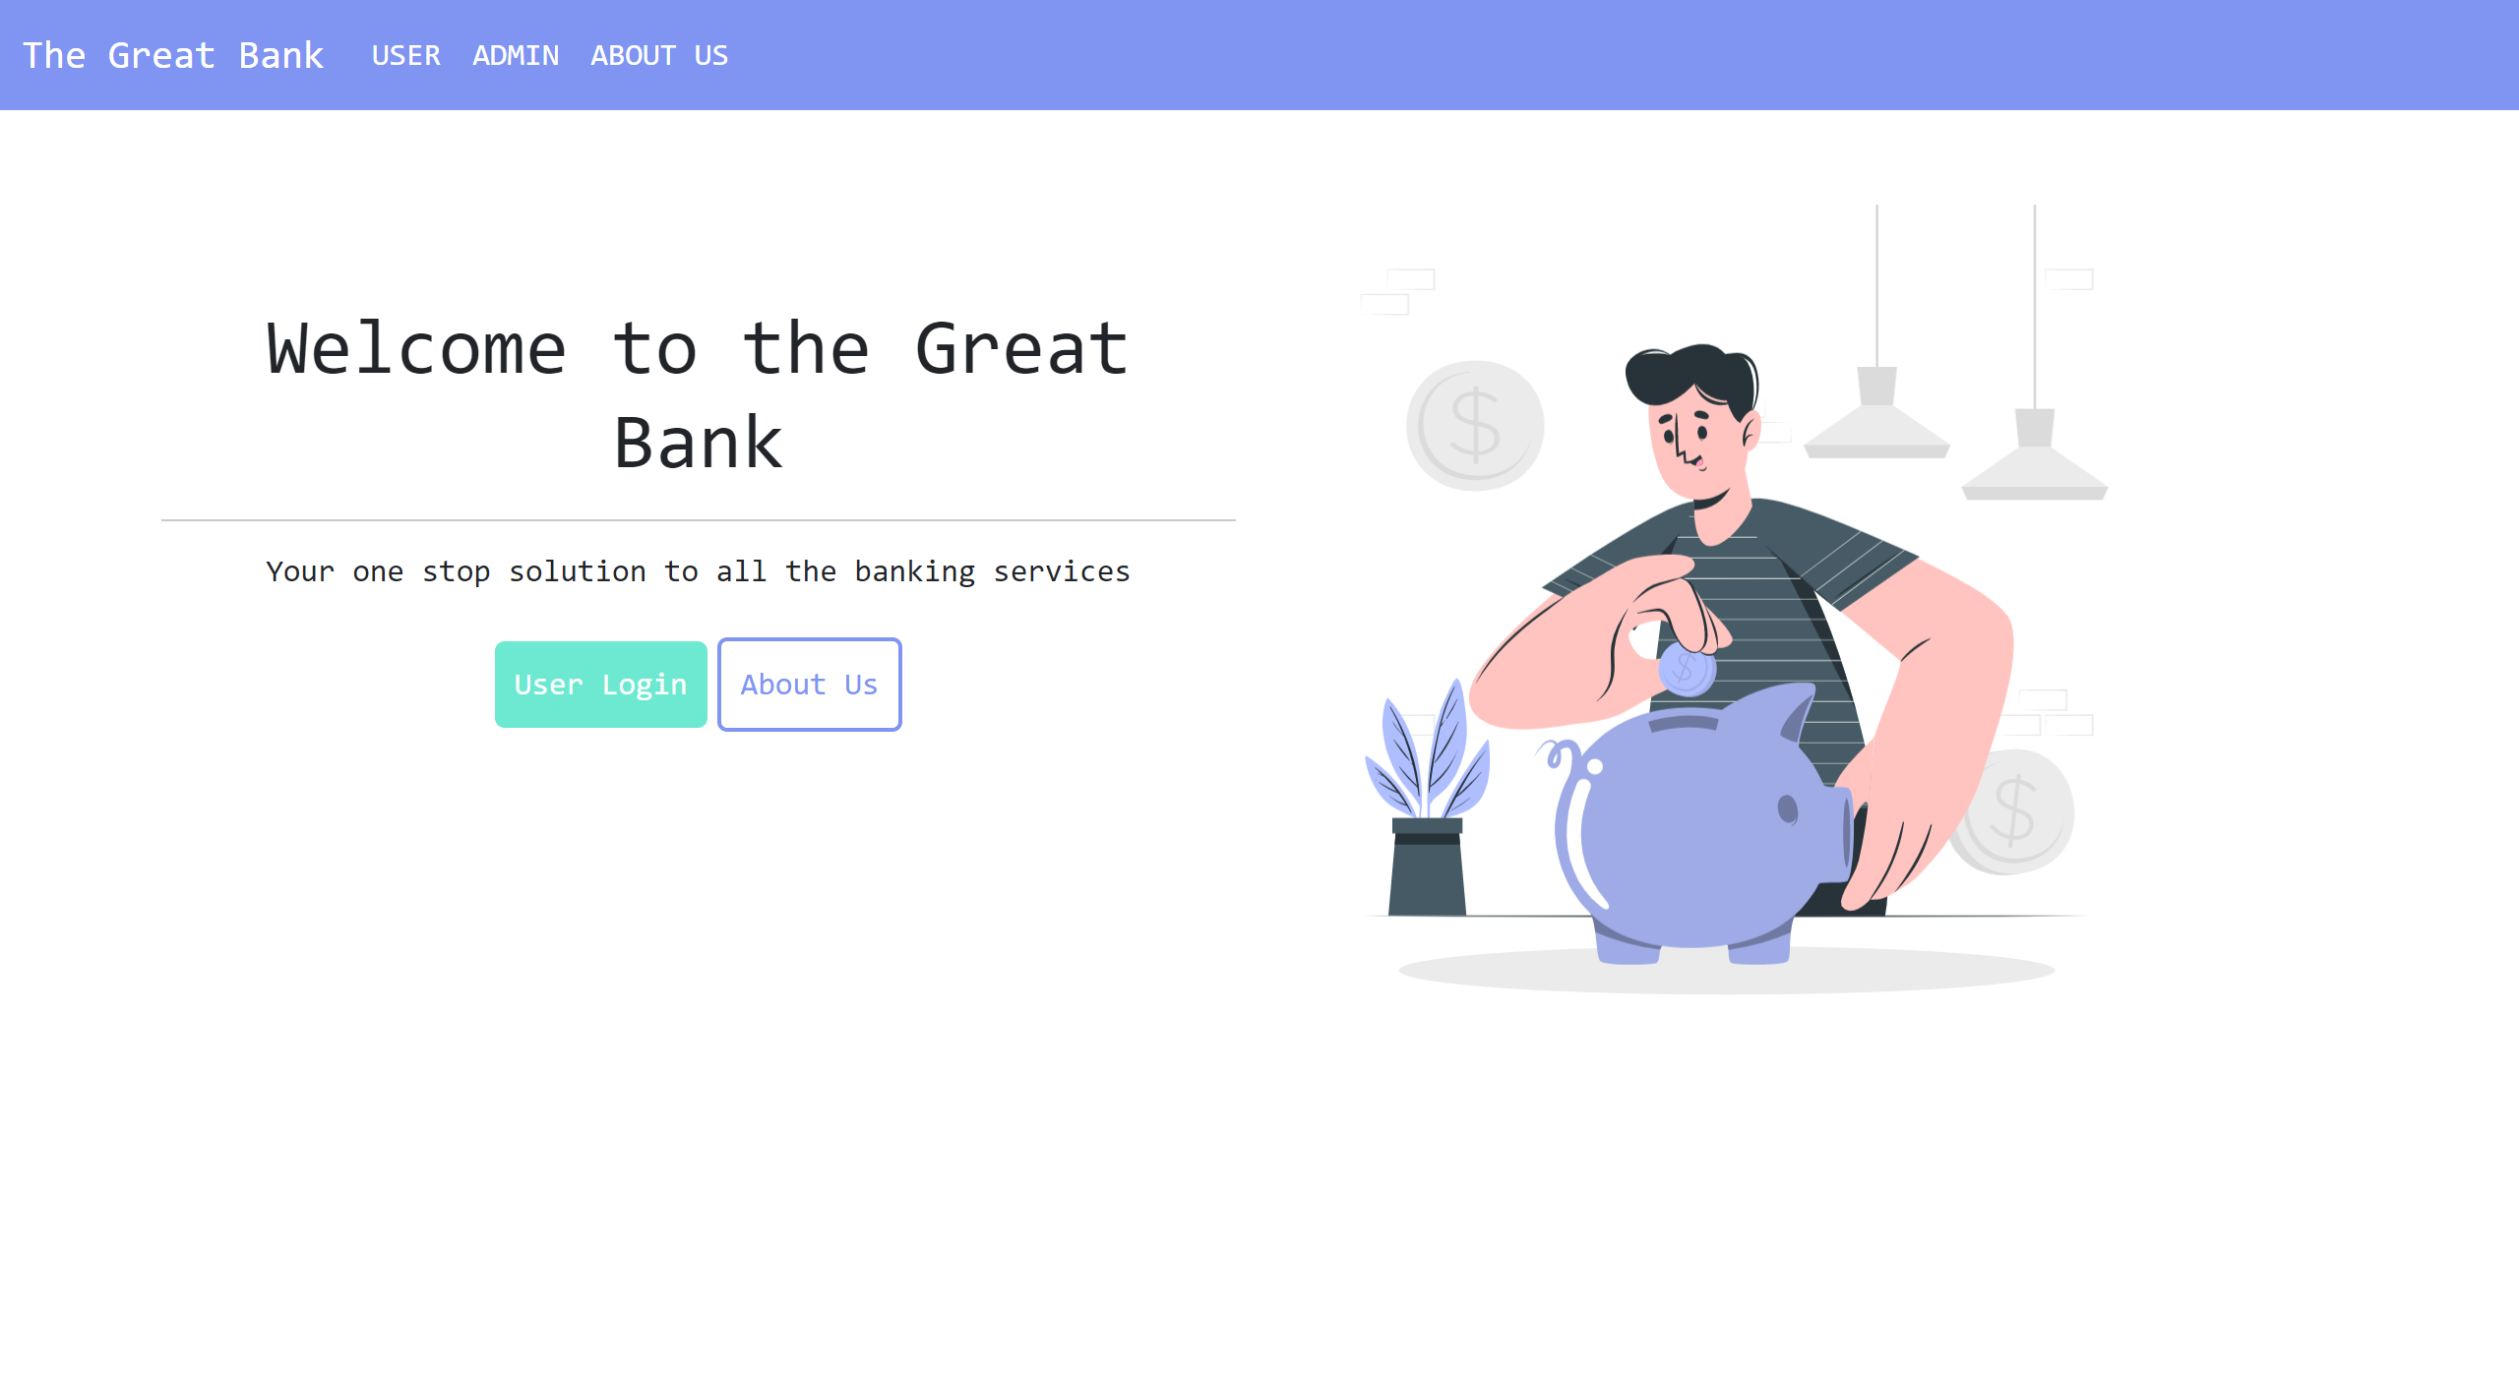
Landing Page
User Lands on this page when the application starts
Include separate login for Employee and Customers.

Slide 14
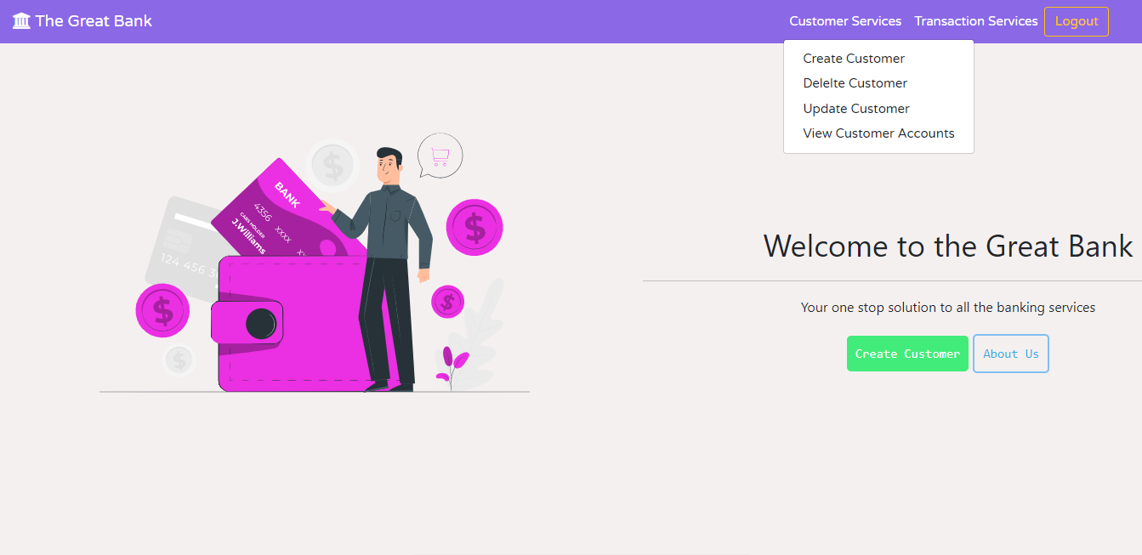
Admin Login
Employee has more features than a customer
Features of Employee
Create Customer
Update Customer
Delete Customer
View Customer Details
Withdraw
Deposit
Statement
Transaction History

Slide 15
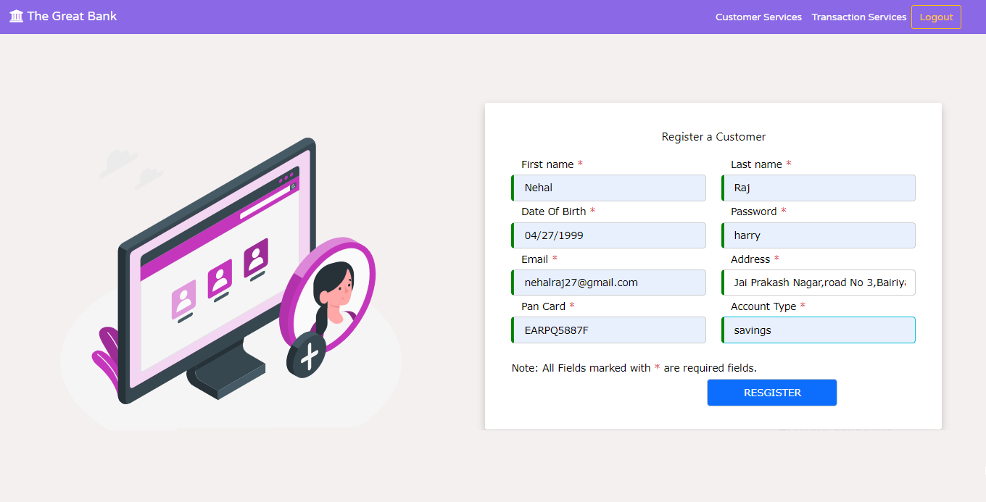
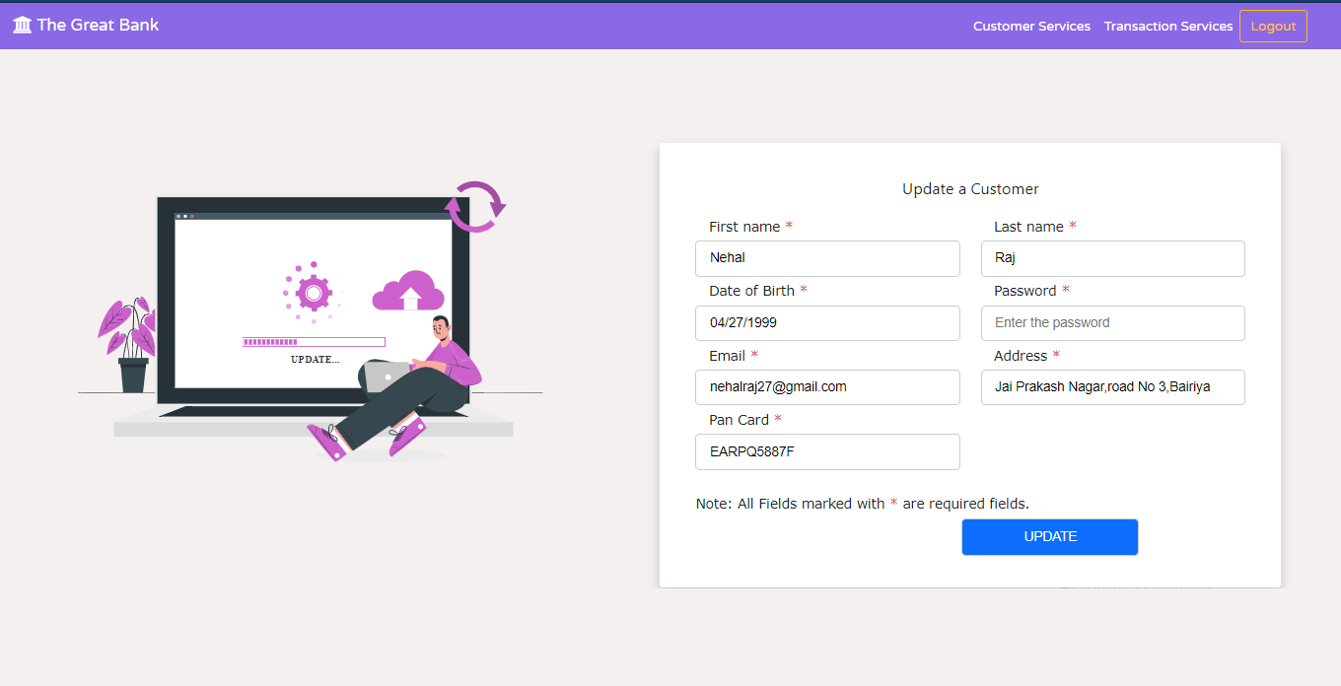
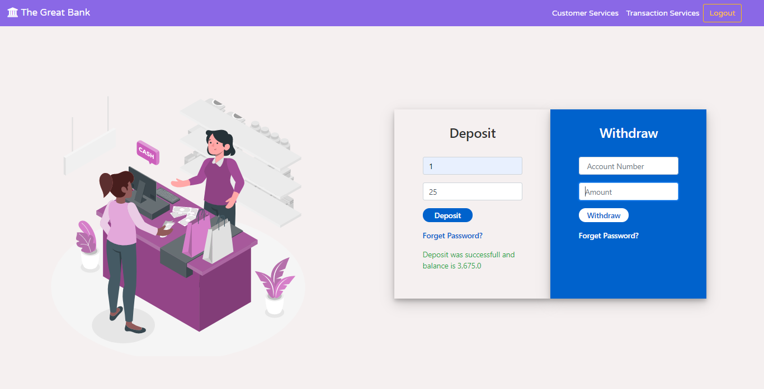
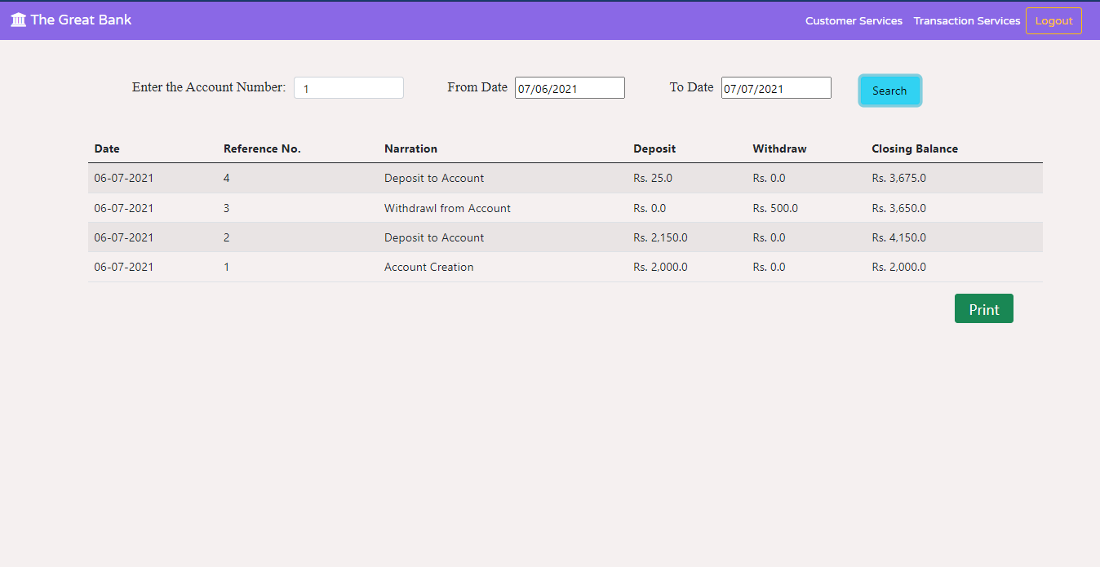
Features of Employee

Slide 16
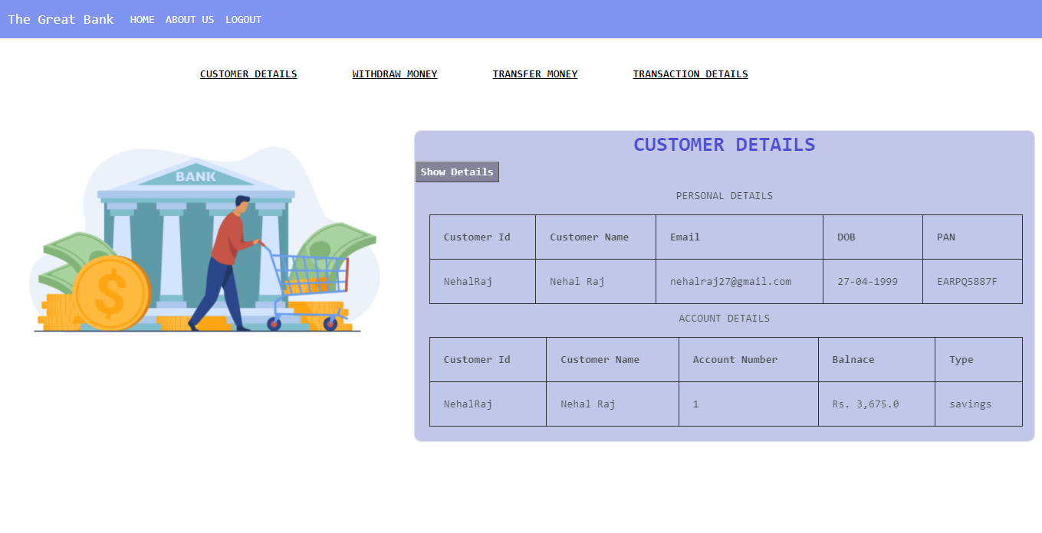
Customer Login
Customer Features are limited as compared to Employee
Features of customer
View its Details
Withdraw Money
Transfer Money
View Transaction History

Slide 17
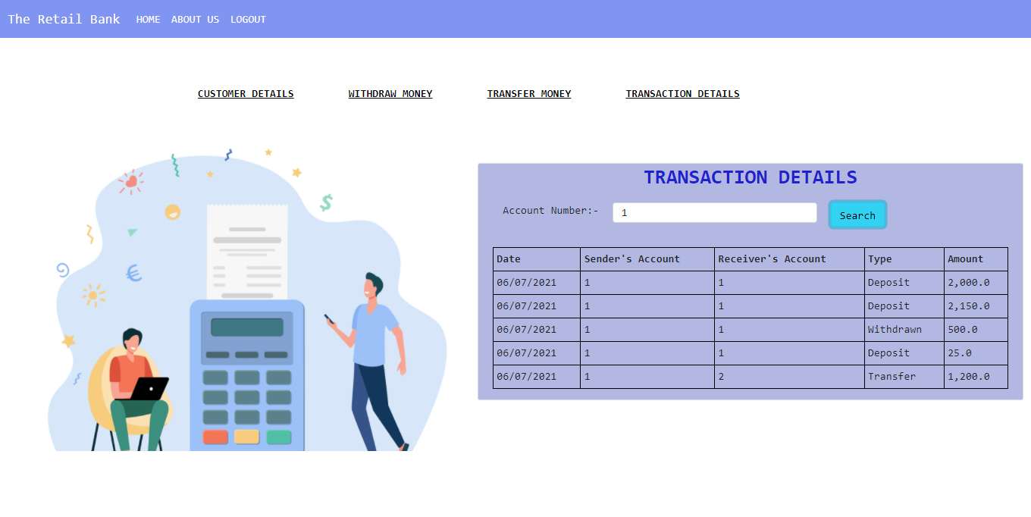
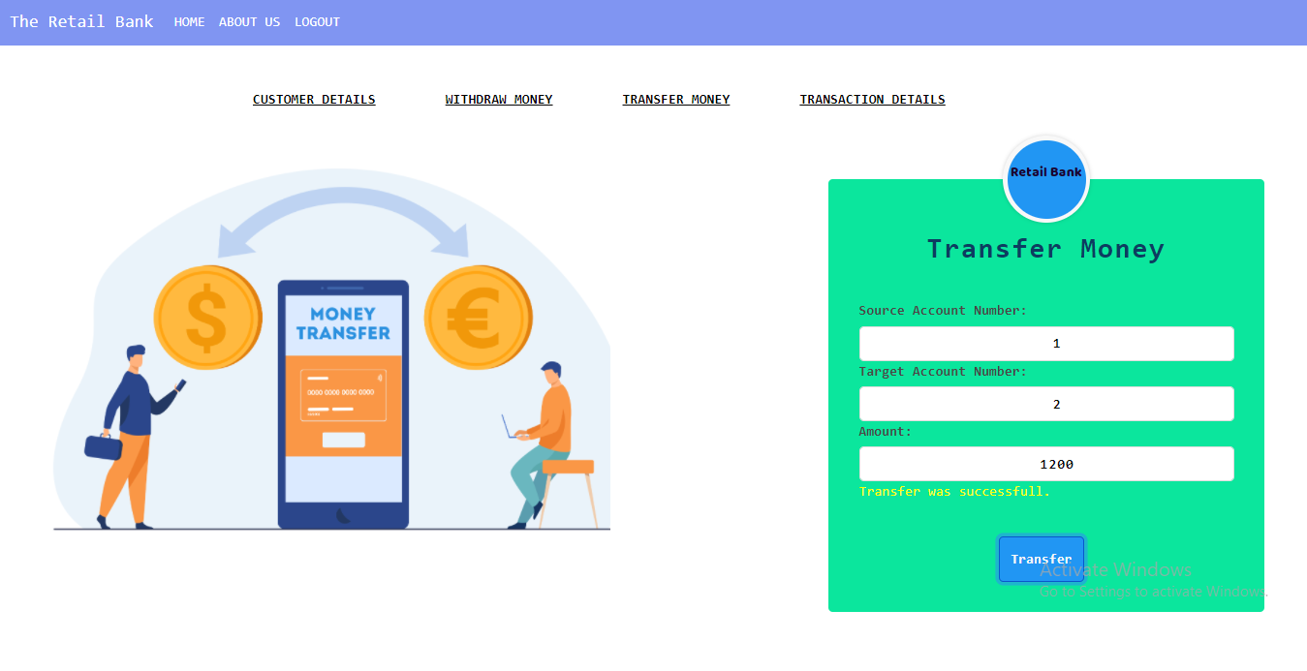
Features of Customer

Slide 18
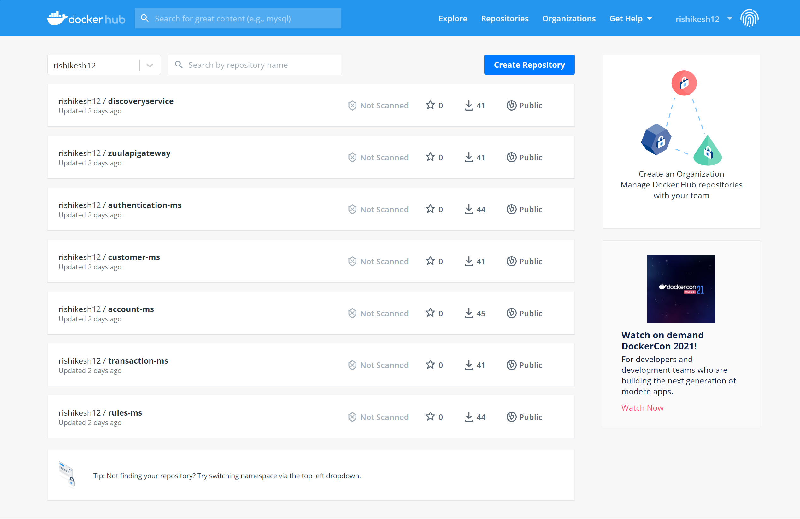
Docker Hub

Slide 19
AWS Snapshots

Slide 20
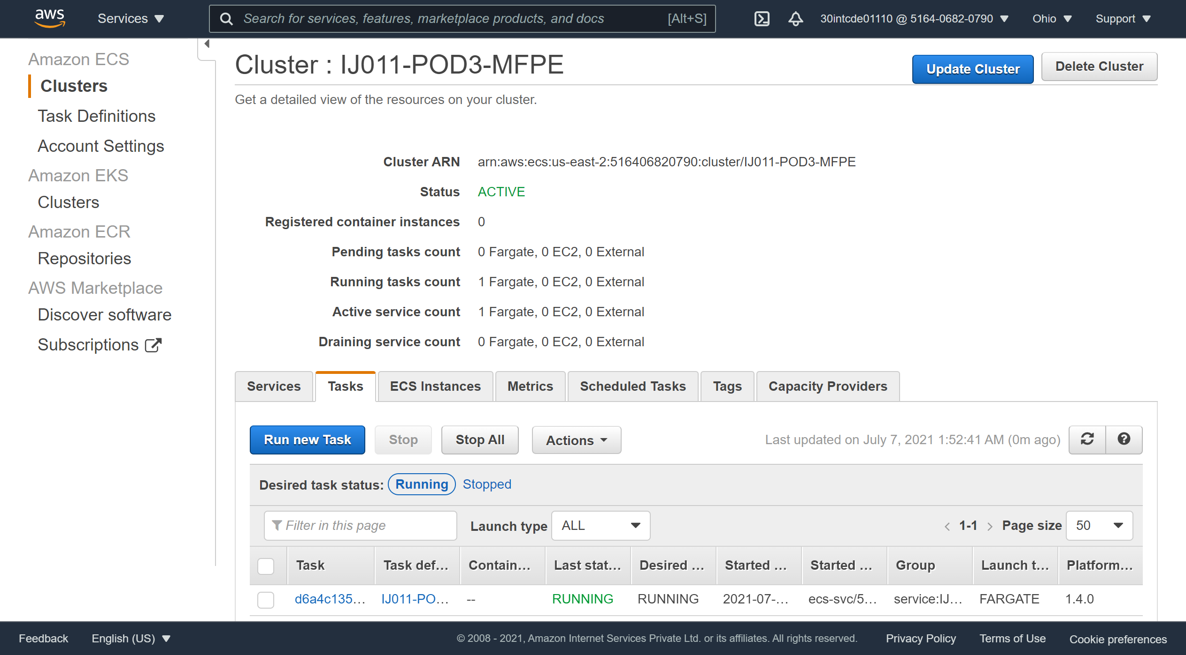
ECS Cluster

Slide 21
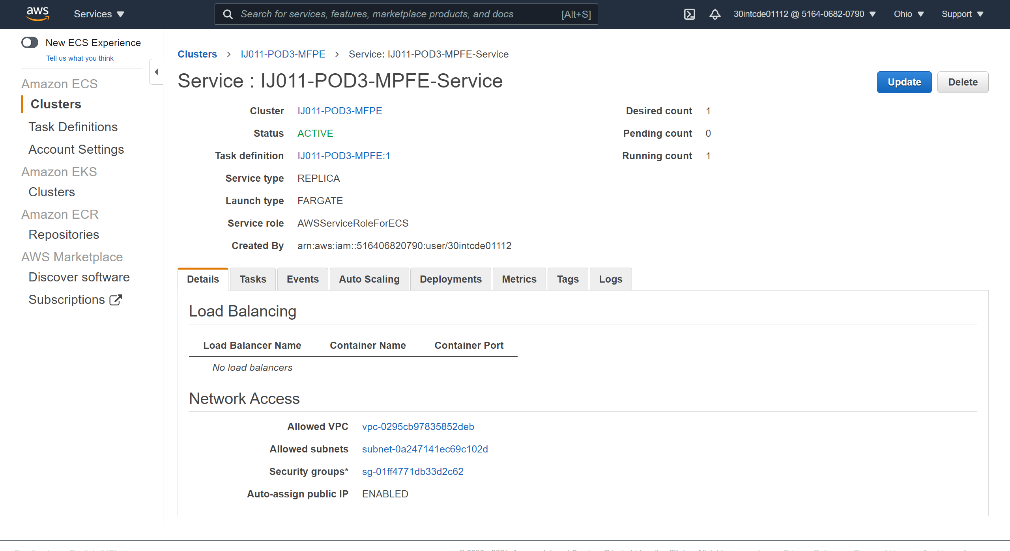
ECS Service

Slide 22
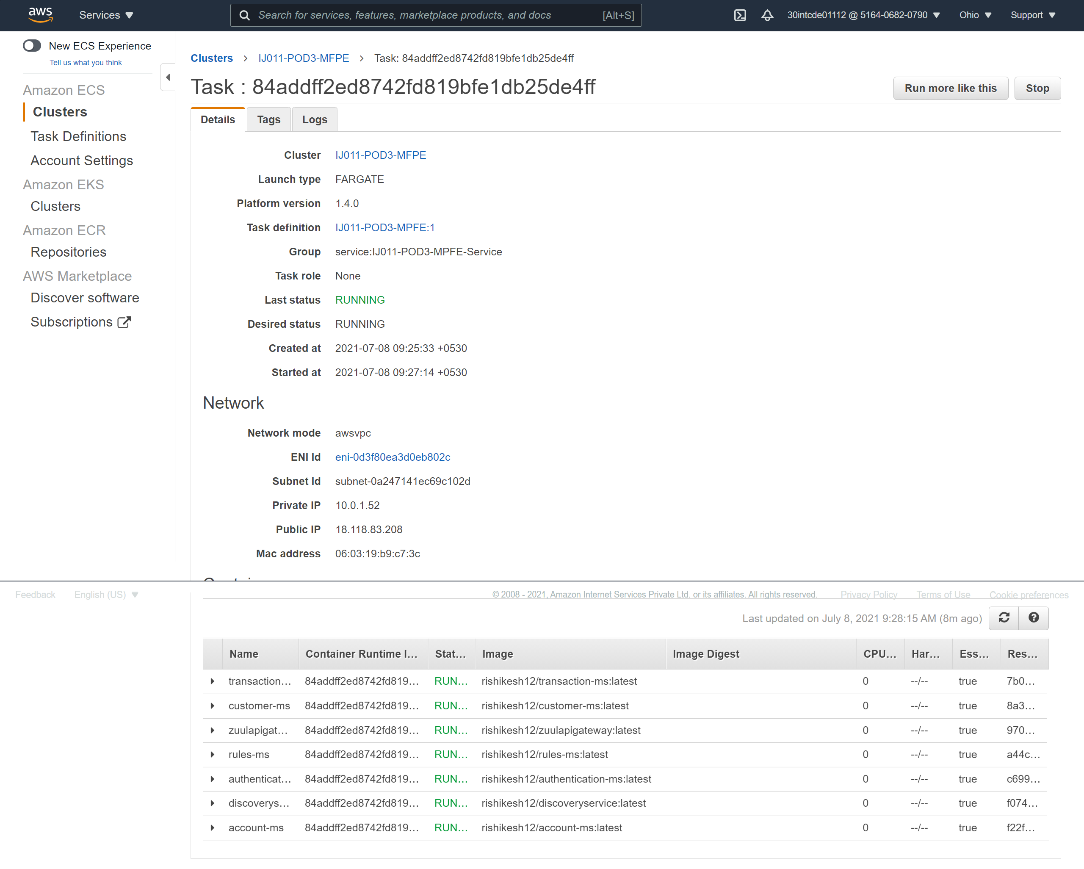
ECS Task

Slide 23
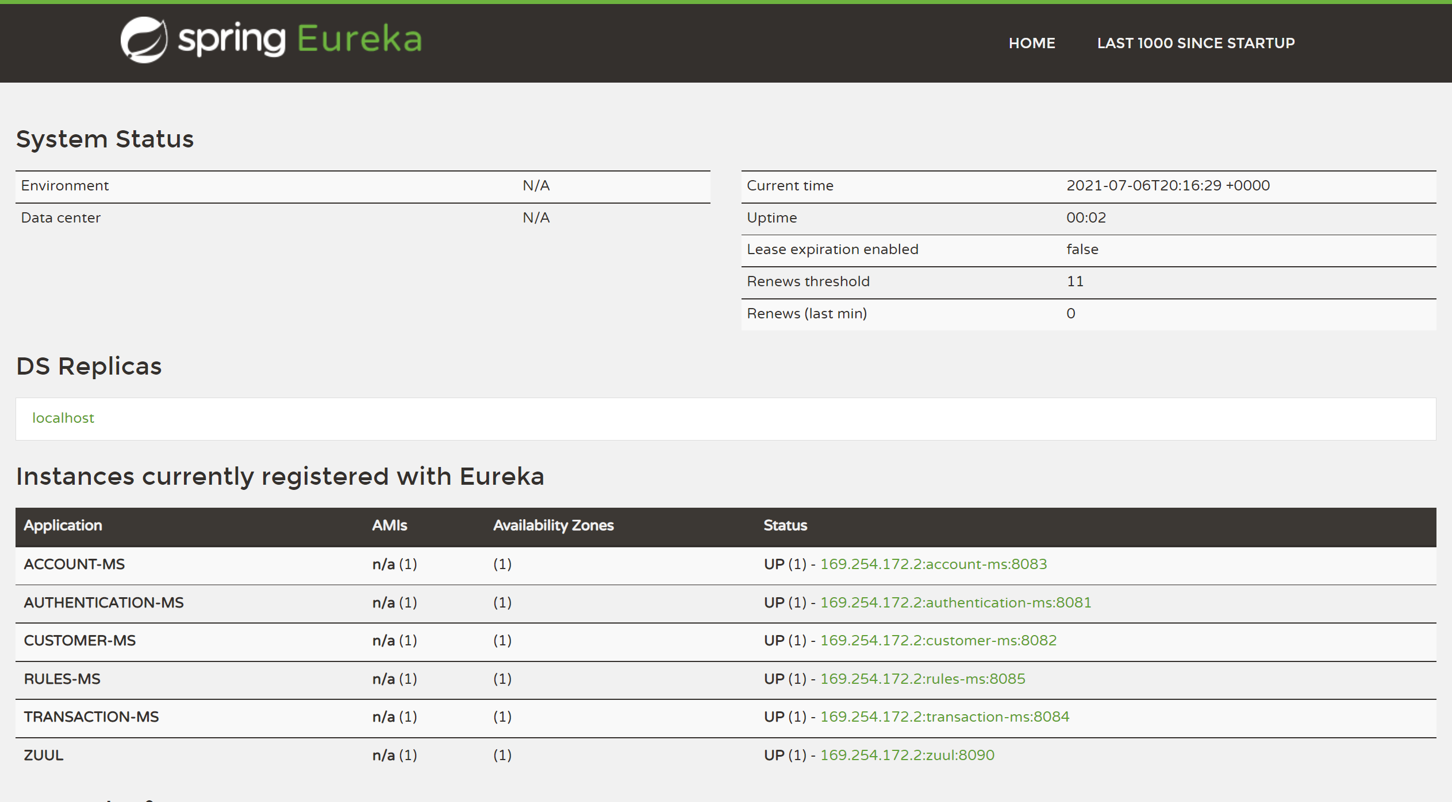
Eureka

Slide 24
Team
N Saumya Vani - 905383
Nehal Raj – 905167
P Venaktesh Patro - 905391
Prateek Jaiswal - 904636
Rishikesh Mishra – 904718
Susha Raghunatha (Mentor)
Krishna Kumar Mandella (Trainer)
Cohort Code – INTCDE21IJ011

Slide 25
Thank You

